Slide 1

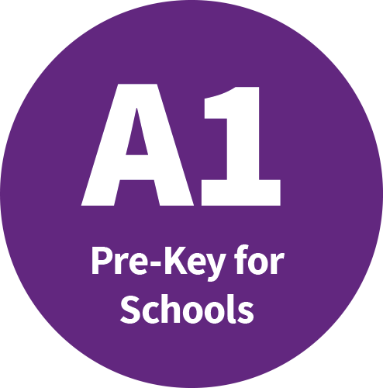
Unit 3 – adverbs of frequency

Slide 2
We use adverbs of frequency a lot in the present simple.
Let’s look at:
When we use adverbs of frequency in the present simple.
Word order of adverbs of frequency in the present simple.
When do we use them?

Slide 3


Function: adverbs of frequency
We use adverbs of frequency a lot in the present simple tense.
My brother works in a zoo. He starts at 9am every day. He usually works with the elephants, but he sometimes helps with the monkeys too. He never works with the snakes. My brother is always happy because he loves his job. He often works many hours every day.
B.
100% frequency
always
Here are two examples in the present simple.
A. My brother works in a zoo.
B. He starts at 9am every day.
Which example is a routine?
First, let’s remember when we use the present simple…
85% frequency
usually
75% frequency
often
A
Which example is a fact – something that is true?
We use adverbs of frequency to say how often we do an action. Put the adverbs in bold on the scale. The first one is done for you.
Frequency
25% frequency
sometimes
0% frequency
never

Slide 4
Function: adverbs of frequency
We use adverbs of frequency a lot in the present simple tense to say how often or with what frequency we do an action.
My brother works in a zoo. He starts at 9am every day. He usually works with the elephants, but he sometimes helps with the monkeys too. He never works with the snakes. My brother is always happy because he loves his job. He often works many hours every day.
100% frequency
My brother is always happy.
All these words tell us the frequency of an action.
85% frequency
He usually works with the elephants.
75% frequency
He often works many hours every day.
Frequency
25% frequency
He sometimes helps with the monkeys.
0% frequency
He never works with the snakes.
Word order…

Slide 5
Form: adverbs of frequency and word order
My brother works in a zoo. He starts at 9am every day. He usually works with the elephants, but he sometimes helps with the monkeys too. He never works with the snakes. My brother is always happy because he loves his job. He often works many hours every day.
Look at what the boy says again. Put the rules in the correct column.
 | with the verb to be | with all other verbs
rules
examples
Adverb of frequency goes after the verb.
Now match the examples above. The first one is done for you.
4. My brother is always happy.
1. He usually works with the elephants.
Adverb of frequency goes before the verb.
2. He sometimes helps with the monkeys.
3. He never works with the snakes.
5. He often works many hours.

Slide 6
Form: adverbs of frequency and word order
My brother works in a zoo. He starts at 9am every day. He usually works with the elephants, but he sometimes helps with the monkeys too. He never works with the snakes. My brother is always happy because he loves his job. He often works many hours every day.
 | with the verb to be | with all other verbs
rules | Adverbs of frequency go after the verb to be. | Adverbs of frequency go before all other verbs.
examples | 1. My brother is always happy. | 1. He usually works with the elephants. 2. He sometimes helps with the monkeys. 3. He never works with the snakes. 5. He often works many hours.
Notice how the word order is different when we use the verb to be.
after
before
Let’s practise!

Slide 7
Practice activities
Put the words in the correct order to make a sentence.
late / Sarah / often / is / school. /for
always / have / I / orange juice / morning. /in / the
Angela and Tim/ go/ never / zoo./ to / the
Sarah is often late for school.
I always have orange juice in the morning.
Angela and Tim never go to the zoo.
Look at the table and complete the sentences with the correct adverb.
Lily………………………...….wakes up at 6am.
James…………………….….wakes up at 6am.
Martin……………………..….wakes up at 6am.
Mary…………………………..wakes up at 6am.
Robin………………….………wakes up at 6am.
always
name | frequency
Lily | 100%
James | 0%
Martin | 85%
Mary | 25%
Robin | 75%
never
usually
sometimes
often

